Slide 1

veHICLE NUMBER PLATE DETECTION AND RECOGNITION USING PYTHON.

Slide 2
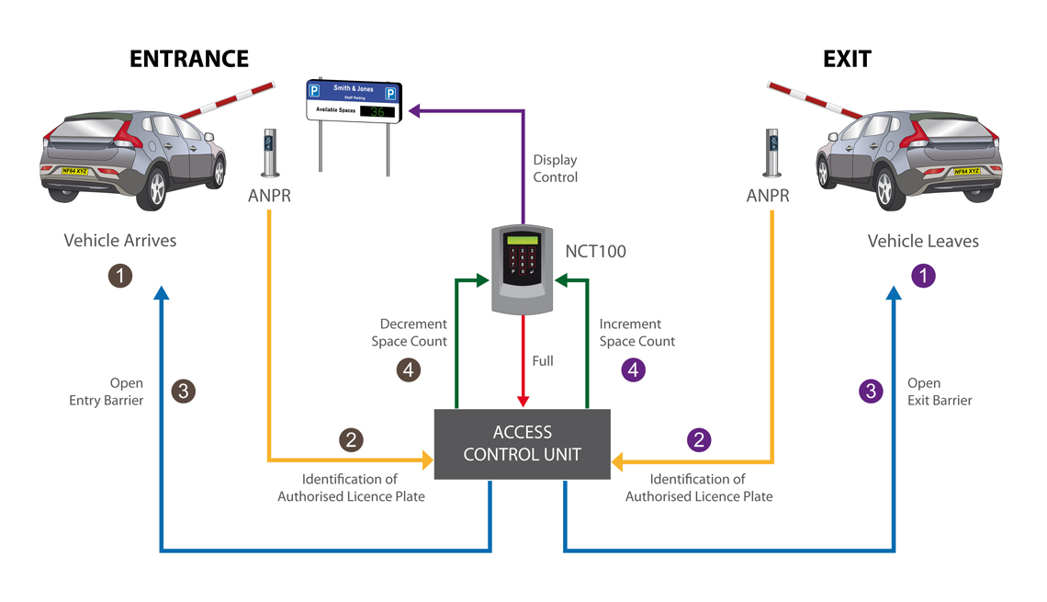
Vehicle Number Plate Recognition System Using TESSERACT-OCR
Automated number plate recognition (ANPR) is a technology that uses optical character recognition (OCR) to automatically read and identify vehicle license plate numbers. The system typically consists of a camera, which captures an image of the license plate, and software that processes the image to extract the plate number. The extracted plate number is then compared against a database of known or registered plate numbers to determine the vehicle's identity. ANPR can be used for a variety of purposes, such as traffic monitoring, toll collection, and parking enforcement, as well as for security and law enforcement applications..
4

Slide 3

The methods and languages that are commonly used in the process of Automated Number Plate Recognition (ANPR):
Image Capture: A camera is used to capture an image of the license plate.
Image Pre-processing: The captured image is processed to enhance the quality of the image, such as removing noise and adjusting the contrast.
License Plate Detection: The image is then scanned to locate the license plate in the image and crop it out.
Character Segmentation: The characters on the license plate are then segmented and isolated.
Optical Character Recognition (OCR): OCR is used to recognize and extract the characters from the segmented license plate image.
Character Recognition: The recognized characters are then matched against a database of known or registered plate numbers to determine the vehicle's identity.
Data processing: The extracted data is further processed using some algorithm to match the license number with the vehicle owner.
5

Slide 4

Programming languages commonly used in ANPR systems include:
Python
C++
Matlab
C#
Additionally, open-source libraries such as OpenCV and Tesseract OCR are commonly used for image processing and OCR functionality.
It's also important to note that, ANPR systems are not 100% accurate and can sometimes produce errors, which is why it is often used in conjunction with other systems such as CCTV cameras, to confirm the identity of a vehicle.
•

Slide 5
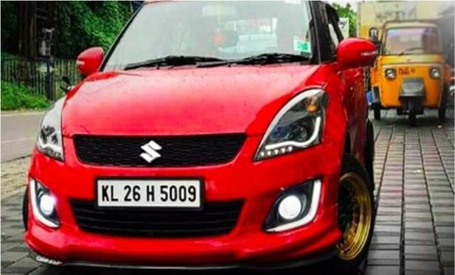
Methodology
PROCESS OF ANPR
3.1ImageAcquisition
Input image captured through camera.
Fig.1CapturedImage
3.2ImagePre-Processing
3.2.1RGB To GRAY Conversion:The use of color images does not aid in the identification of significant edges and other characteristics.Processing an RGB image is complicated and takes a long time,there fore we must first convert the colored image to a gray scale image.

Slide 6
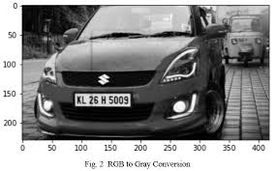
Fig.2RGBtoGrayConversion
    Image Enhancement : The purpose of adaptive histogram equalization is to improve the contrast of a picture(gray color image).In this step, we will create many histograms, each representing a different part of the image. In contrast to a typical histogram, which shows just one histogram for the whole image,this one shows the complete image.
    Noise Removal:To remove noise in the image.
3.3 Edge Detection:
An edge is a line drawn between two places that have grey level qualities that are significantly different from one another. It is capable of detecting discontinuities in the intensity levels .The first stage in the recognition of a plate is to determine the size of the plate(which is a rectangle); thus ,we must determine the edge of a rectangular plate.The edges of the image are emphasized with the help of the sobaloperator.As a result, the quantity of data in the image is reduced,and the necessary data is processed for subsequent use.

Slide 7
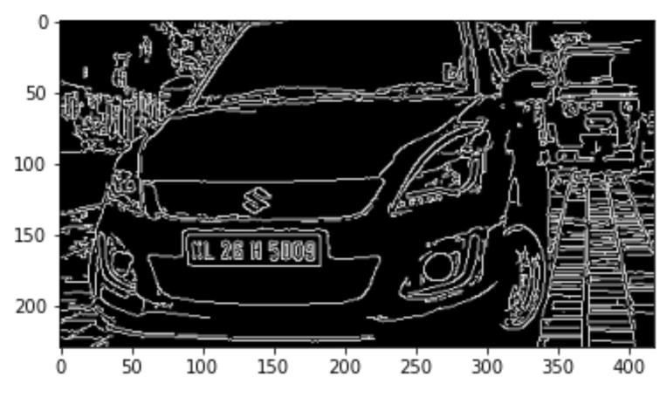
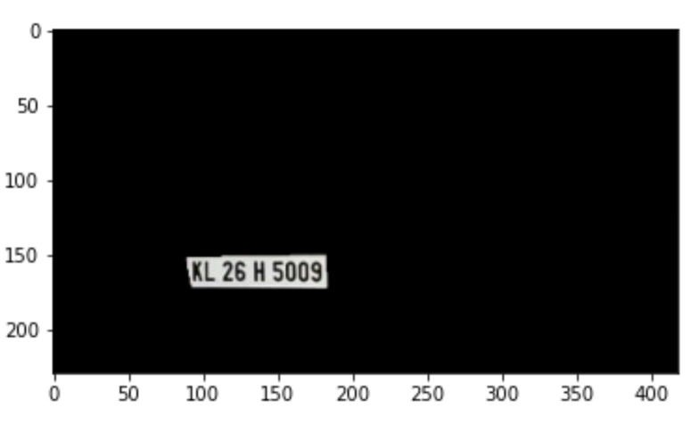
Fig.3Afteredgedetection
3.4Morphological Image Processing
The output of the structuring element must be the same size as the input. By using dilation and by adding pixels to the object's border,we may make the boundaries appear thicker than they actually are.Using the Shrinking process ,thinning the picture to remove any unnecessary bits is accomplished.
Fig.4Numberplaterecognized

Slide 8
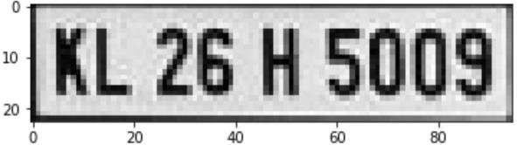
3.5Threshold
If the specified threshold value is exceeded or not, two separate levels are assigned to pixels that fall above and below the threshold value.In order to distinguish an item from a background image,the image is transformed to binary form . The technique of
Determining the grey level threshold is straight forward . To compare pixels in a picture,the value of the threshold(T) is determined and used . Aside from that, it converts the input binary image(K) in to an output binary image(F)that is then segmented. Global threshold is used to segment the histogram of an image using a single threshold value , as opposed to local threshold. When we talk about threshold, we are referring to the volume of grey level that falls between the baseline border, which is located between the pixels found in the foreground and the background.
3.6 Segmentation
In between the number plate extraction and character recognition,character segmentation serves as a transitional step.There are several segments for the different characters on a number plate region.
Various factors,such as illumination variations, plate frames,and rotation,all contribute to the inability to complete the segmentation task.A segmentation approach is sometimes referred to as a boundary box analysis in some circles.Characters are allocated to related components using this approach,and these characters are then extracted using the boundary box. When the amount of noise in the image has been reduced,the segmentation procedure is complete.
Fig.5Numberplatesegmentedimage

Slide 9
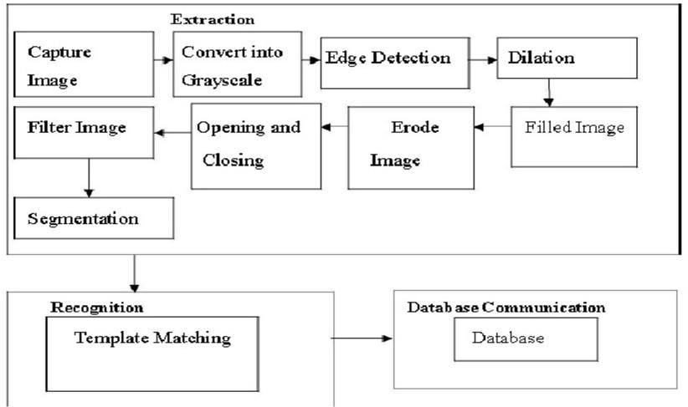
3.7CharacterRecognition
Character recognition is accomplished by employing feature extraction to extract the characteristics of characters and their different categorization procedures, which is a step in the character recognition process.The identification of characters from the number plate is accomplished through the use of a machine learning system.
Fig.6PyTesseract OCR output
Fig.6FlowchartofAutomaticNumberPlateRecognition

Slide 10
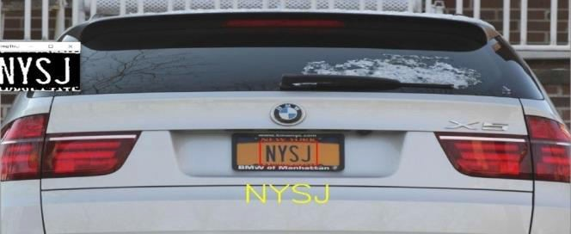
Result and Discussions
Initially, the camera will be used to capture the image. Once the image is captured, the algorithm will process it by converting it into grayscale, followed by extracting the possible number plates and finally recognizing the registration number of the vehicle. The final registration details will be searched from the database and will be displayed on the screen

